Slide 1


Sign Language Assistant Hub Using Tensorflow, Inception, JavaFx
Harnessing the Power of Deep Learning and Java GUI

Slide 2
Computer System Engineering 3RD Semester 2022F
Uzair Arif Jokhio 22F-CS-17
Safdar Sheikh 22F-CS-15

Slide 3
Introduction:
SLASH is an important tool of communication for the hearing-impaired community.
Goal of the Project:
Creating
Creating a system to detect Sign Language using TensorFlow, Inception, Java, and JavaFX.
Combining
Combining a deep learning model (Inception) with a user friendly Java Frontend

Slide 4
Technology Stack
List of technology Used:
For Frontend:
JavaFX
Scene Builder
For Backend:
Tensorflow
Inception
OpenCV

Slide 5
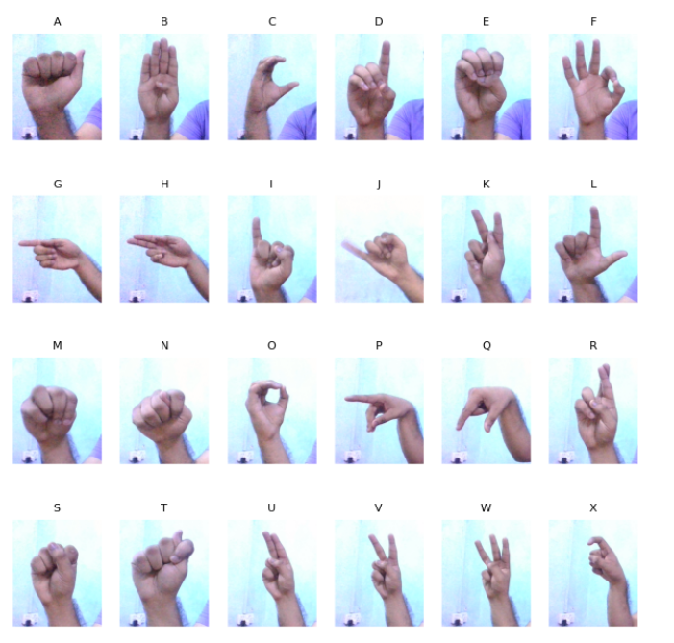
Data Collection
Collecting Data at least 90 images were captured for each Alphabet
The data was collected by using OpenCV in python
Saving the images in “/Image” folder each alphabet having its sub folder
Images Dimension 300x360

Slide 6
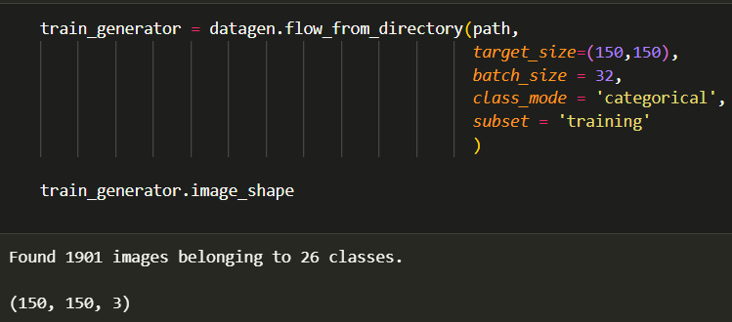
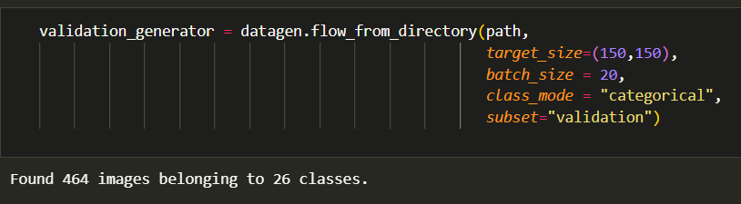
Model Training
Total Images 2,366
80% of images For Training Set and 20% for Testing/validation
Resizing the images to (150, 150, 3)

Slide 7
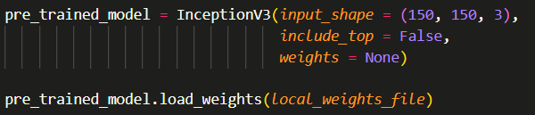
Model Training
Getting pre-trained weights
Loading weight in local inception network
Changing the last layer so that we get our desire output

Slide 8
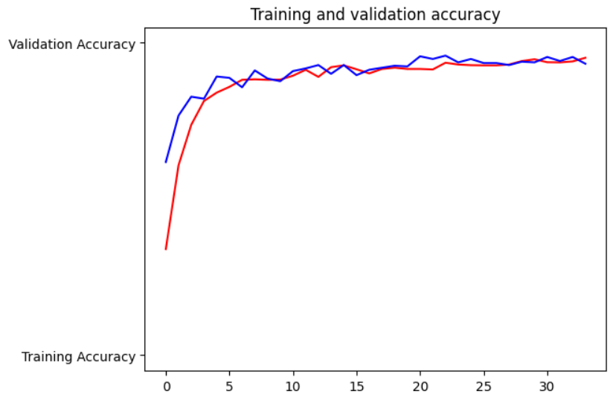
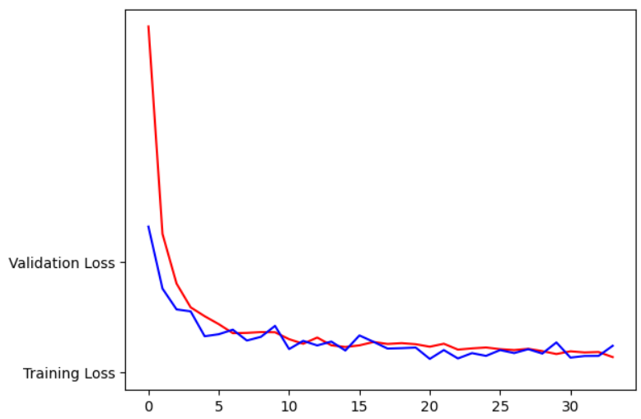
Model Training

Slide 9
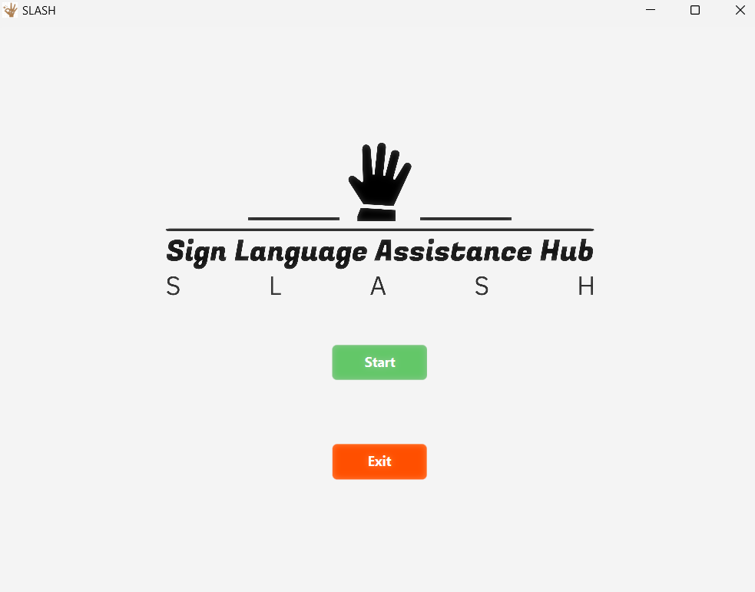
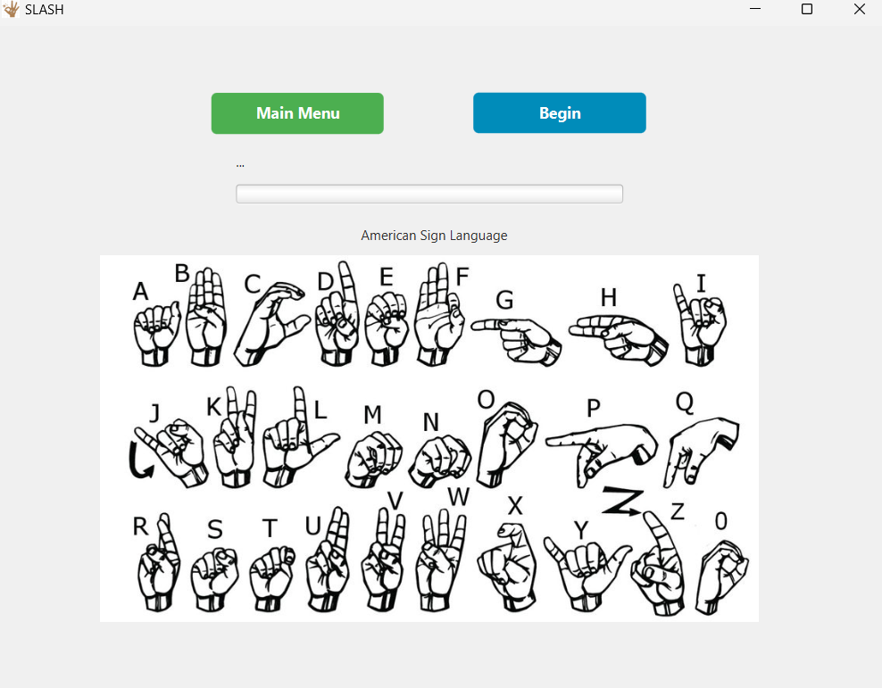
Graphic User Interface
In Java we use JavaFX a famous GUI library to make an interface
Scene Builder is a tool that help in designing GUI
Creating two pages , Main page, Second Page.

Slide 10
Live Demo

